Slide 1
Stage 7: Selling products

Slide 2
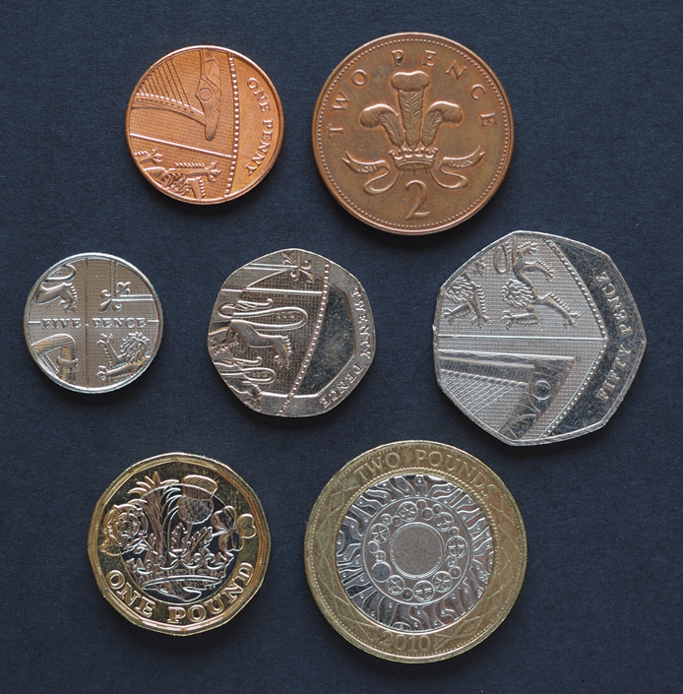
Coins
What do we use coins for?
What does £ mean? What does p mean?
Can you name these coins?

Slide 3
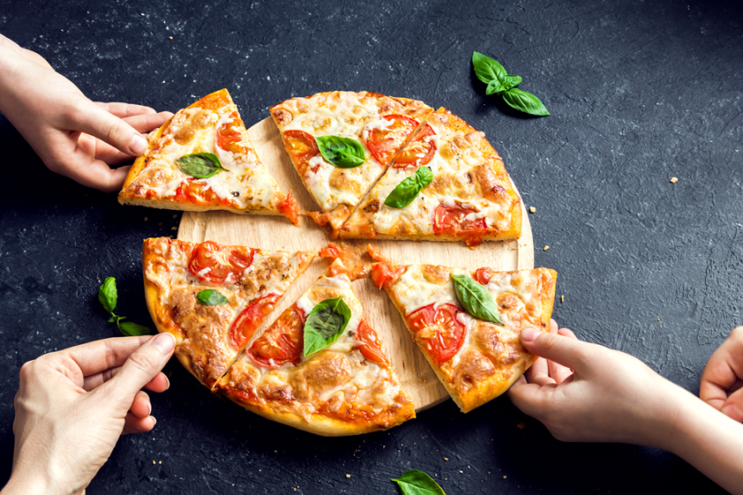
Introduction
Today you will have the opportunity to set up your pizzerias and show off all your hard work on this project.
You will practise being pizzeria owners by serving your classmates.

Slide 4
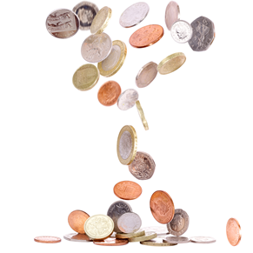
Coin challenge!
How many different combinations of coins can you find to pay for a 45p pizza?

Slide 5
Setting up our pizzerias

